Slide 2
Lecture 14 & 15 DISCRETE STRUCTURE
SARA SHAFIQUE

Slide 3

Lecture Outline
Loop Structure Need
Arguments
Valid Arguments
Invalid Arguments
Quantifiers
Universal Quantifiers
Existential Quantifiers
Rules of Inference
Inference Rules: Propositional and Building Arguments
Lecture Outline

Slide 4
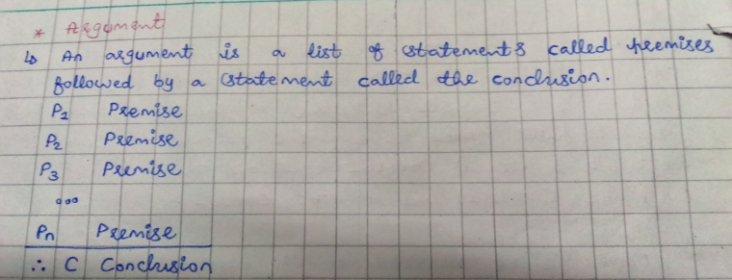

Lecture Outline

Slide 5
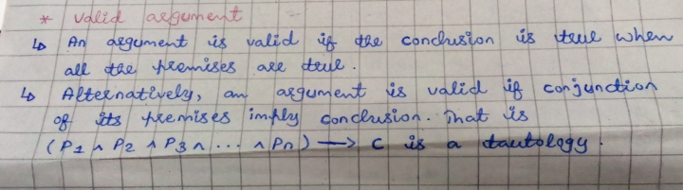
Lecture Outline

Slide 6
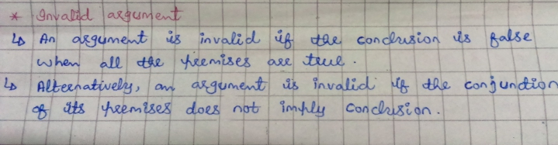
Lecture Outline

Slide 7
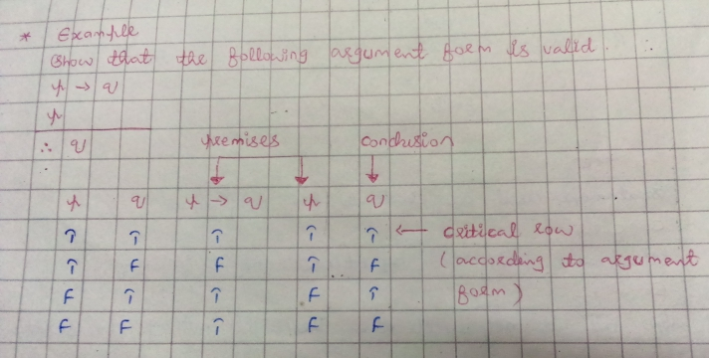
Lecture Outline

Slide 8
Lecture Outline

Slide 9
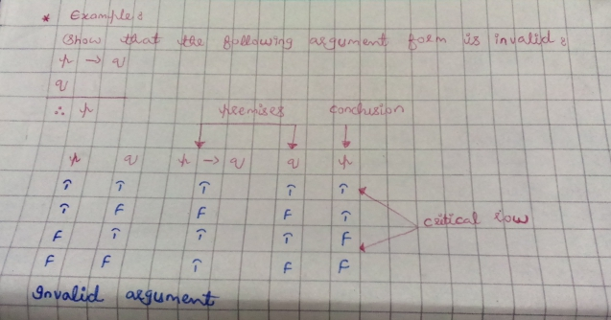
Lecture Outline

Slide 10
Lecture Outline

Slide 11
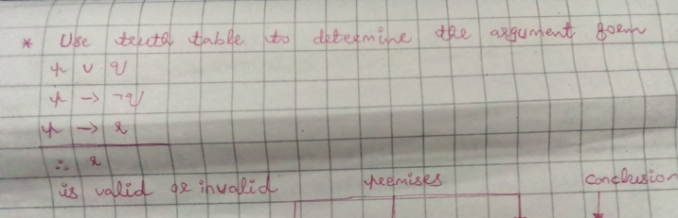
Lecture Outline

Slide 12
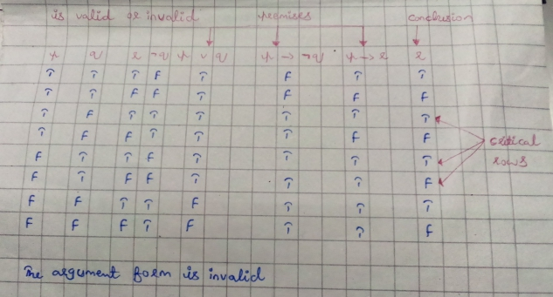
Lecture Outline

Slide 13
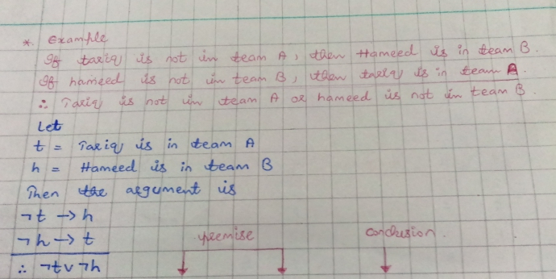
Lecture Outline

Slide 14
Lecture Outline

Slide 15
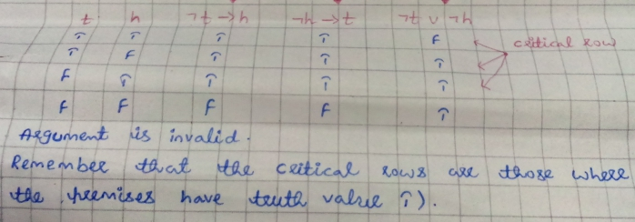
Lecture Outline

Slide 16
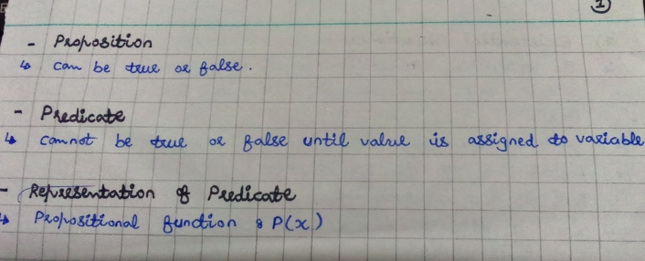

Lecture Outline

Slide 17
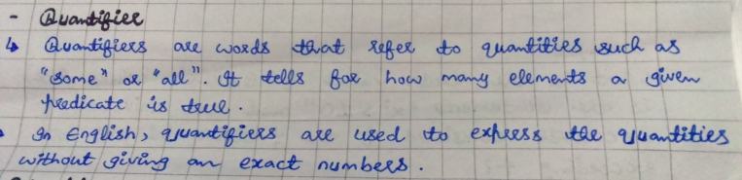
Lecture Outline

Slide 18
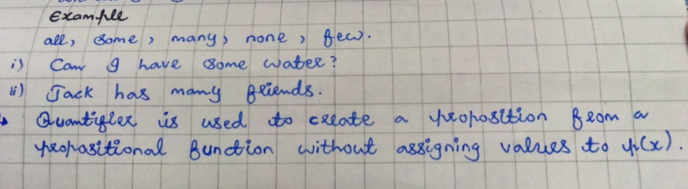
Lecture Outline

Slide 19
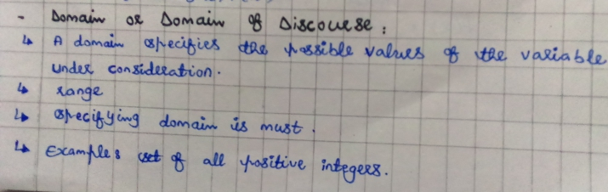
Lecture Outline

Slide 20
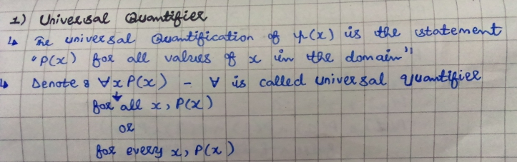
Lecture Outline

Slide 21
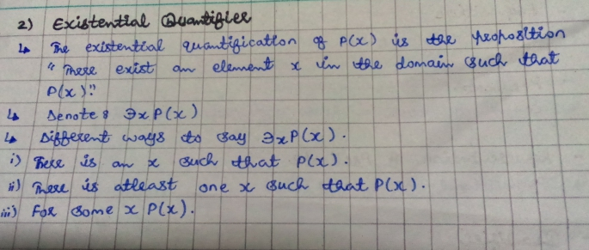
Lecture Outline

Slide 22
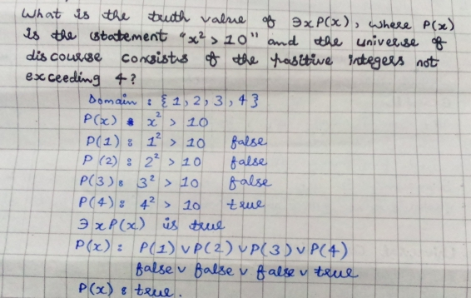
Lecture Outline

Slide 23
Lecture Outline

Slide 24
Lecture Outline

Slide 25
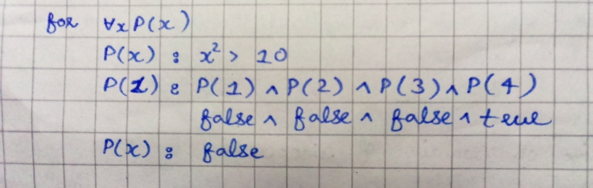
Lecture Outline

Slide 26
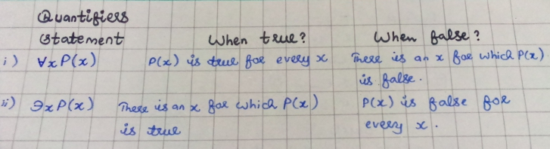
Lecture Outline

Slide 27
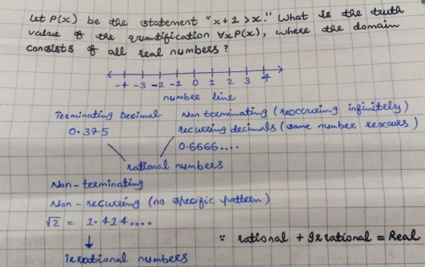
Lecture Outline

Slide 28
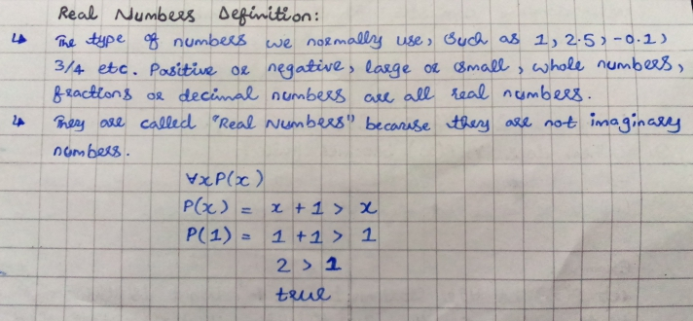
Lecture Outline

Slide 29
Lecture Outline

Slide 30
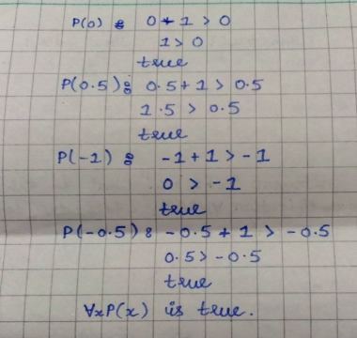
Lecture Outline

Slide 31
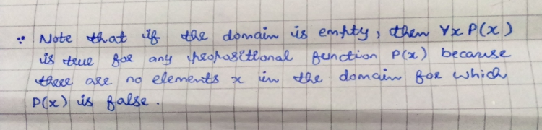
Lecture Outline

Slide 32
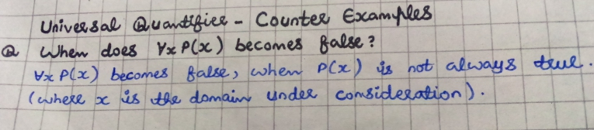
Lecture Outline

Slide 33
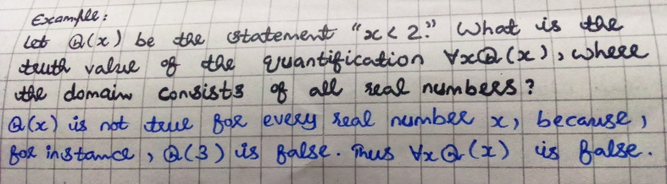
Lecture Outline
Counter Example 1

Slide 34
Lecture Outline
Counter Example 1

Slide 35
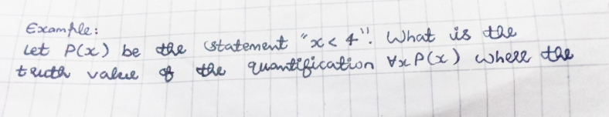
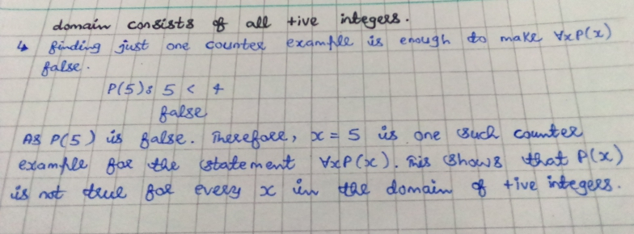
Lecture Outline
Counter Example 2

Slide 36
Lecture Outline
Counter Example 2

Slide 37
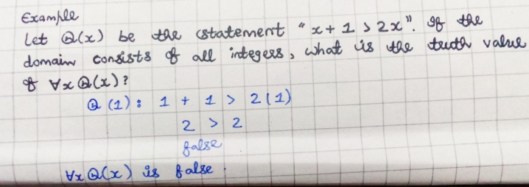
Lecture Outline
Counter Example 3

Slide 38
Lecture Outline
Counter Example 3

Slide 39
Lecture Outline
Rules of Inference
We can always use a truth table to show that an argument form is valid.
However, this can be a tedious approach. For example, when an argument form involves 10 different propositional variables, to use a truth table to show this argument form is valid requires 2^10 = 1024 different rows.
Instead, we can first establish the validity of some relatively simple argument forms, called rules of inference.

Slide 40
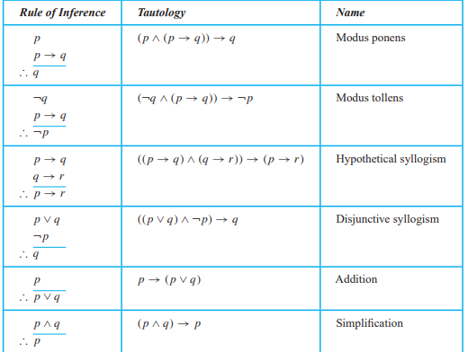
Lecture Outline

Slide 41
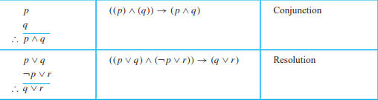
Lecture Outline

Slide 42
Lecture Outline
Examples for Rules of Inference.
Let p be “It is raining,”
and q be “I will make tea,”
and r be “I will read a book.”

Slide 43
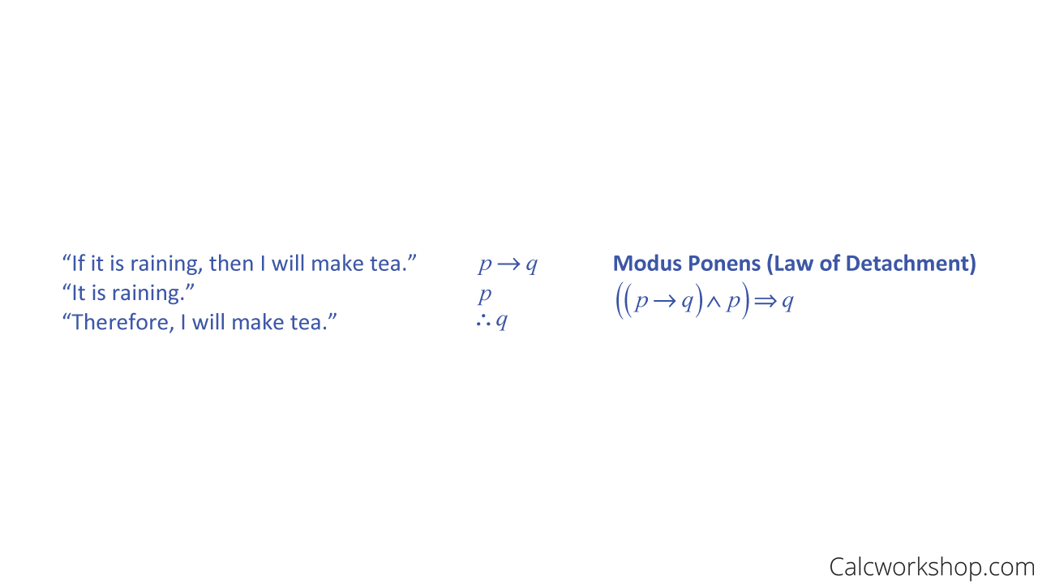
Lecture Outline
Examples for Rules of Inference.
Example — Modus Ponens
Let p be “It is raining,” and q be “I will make tea,” and r be “I will read a book.”

Slide 44
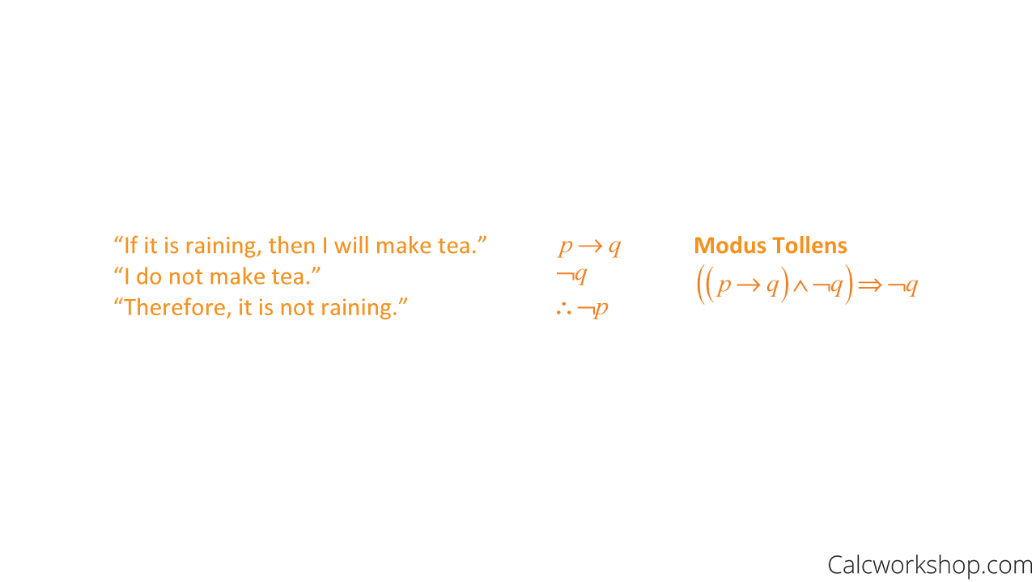
Lecture Outline
Examples for Rules of Inference.
Example — Modus Tollens
Let p be “It is raining,” and q be “I will make tea,” and r be “I will read a book.”

Slide 45
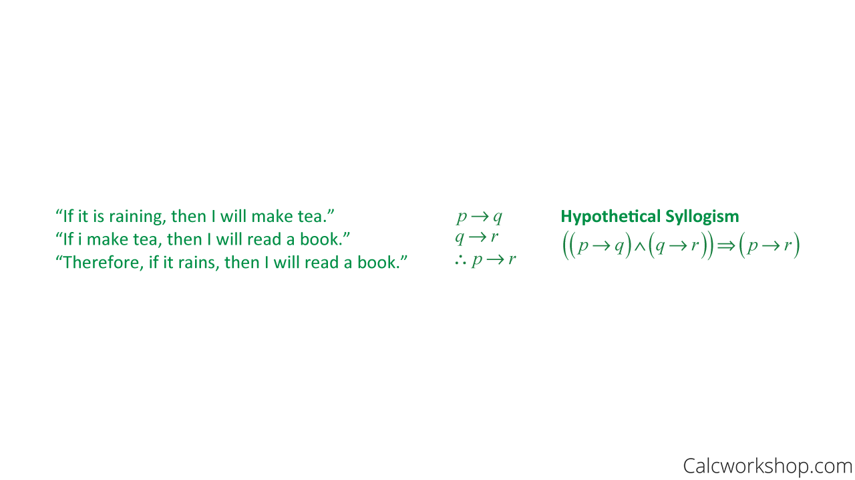
Lecture Outline
Examples for Rules of Inference.
Example — Hypothetical Syllogism
Let p be “It is raining,” and q be “I will make tea,” and r be “I will read a book.”

Slide 46
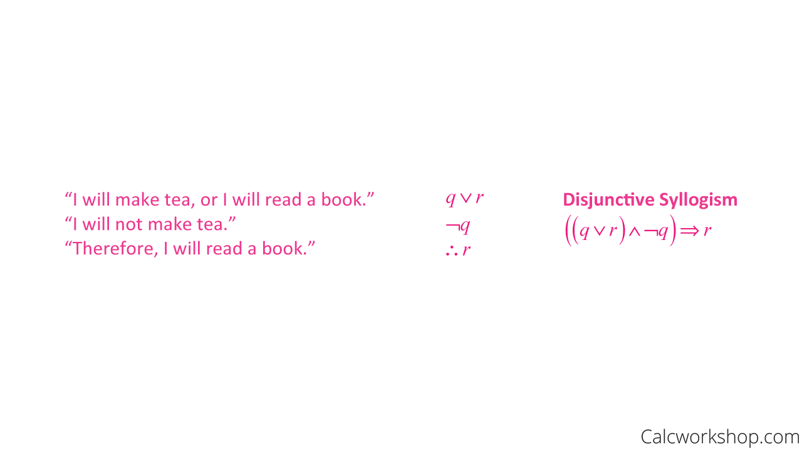
Lecture Outline
Examples for Rules of Inference.
Example — Disjunctive Syllogism
Let p be “It is raining,” and q be “I will make tea,” and r be “I will read a book.”

Slide 47
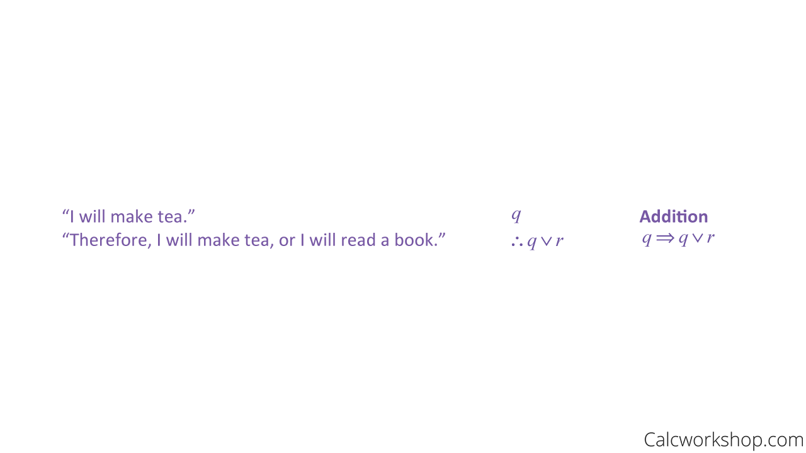
Lecture Outline
Examples for Rules of Inference.
Example — Addition
Let p be “It is raining,” and q be “I will make tea,” and r be “I will read a book.”

Slide 48
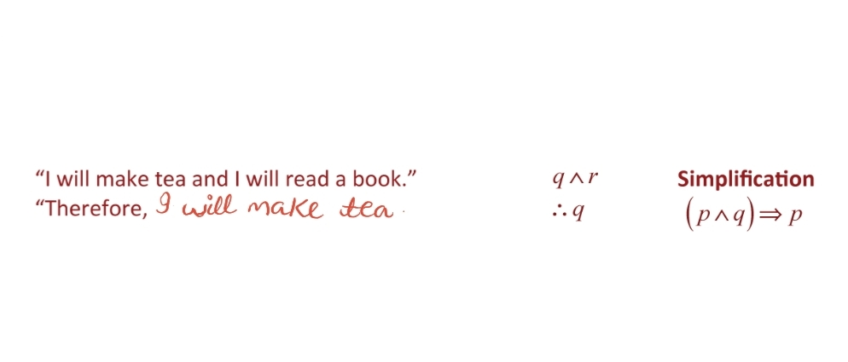
Lecture Outline
Examples for Rules of Inference.
Example — Simplification
Let p be “It is raining,” and q be “I will make tea,” and r be “I will read a book.”

Slide 49
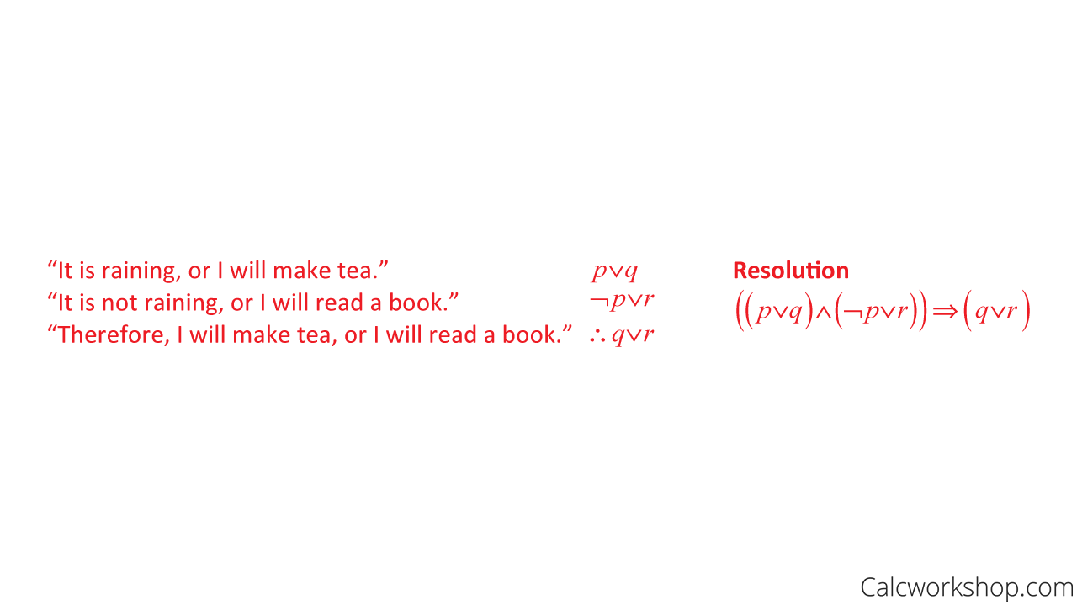
Lecture Outline
Examples for Rules of Inference.
Example — Resolution
Let p be “It is raining,” and q be “I will make tea,” and r be “I will read a book.”

Slide 50
Lecture Outline
Valid Vs Invalid Argument
Now let’s see if we can determine if an argument is valid or invalid using our logic rules.
Test the validity of the argument:
If it snows, Paul will miss class.
Paul did not miss class.
Therefore, it did not snow.

Slide 51
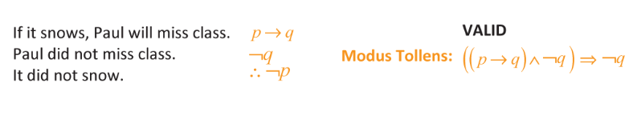
Lecture Outline
Valid Vs Invalid Argument
Test the validity of the argument:
If it snows, Paul will miss class.
Paul did not miss class.
Therefore, it did not snow.
First, we will translate the argument into symbolic form and then determine if it matches one of our rules.
Because the argument matches one of our known logic rules, we can confidently state that the conclusion is valid

Slide 52
Lecture Outline
.
Let’s look at another example.
Test the validity of the argument:
If it snows, Paul will miss class.
It did not snow.
Therefore, Paul did not miss class.

Slide 53
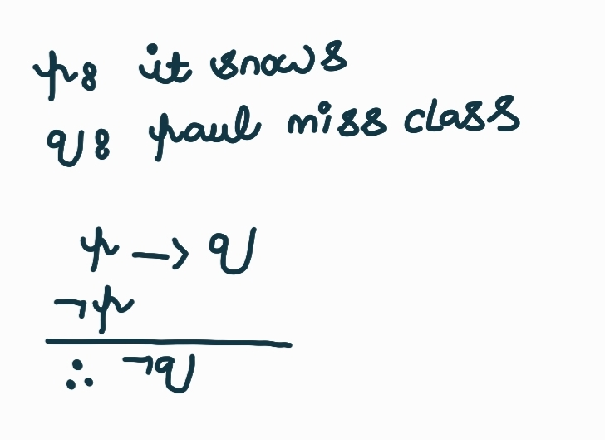
Lecture Outline
.
Let’s look at another example.
Test the validity of the argument:
If it snows, Paul will miss class.
It did not snow.
Therefore, Paul did not miss class.
Because the argument does not match one of our known rules, we determine that the conclusion is invalid.

Slide 54
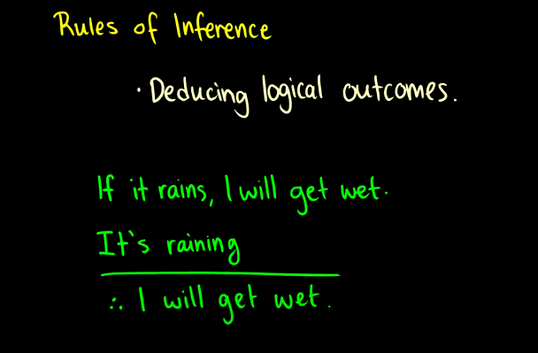
Lecture Outline

Slide 55
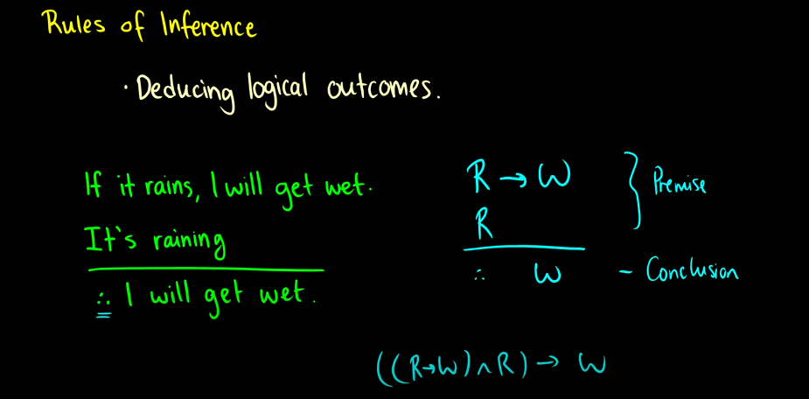
Lecture Outline

Slide 56
Lecture Outline
Inference Rules: Propositional and Building Arguments
When there are many premises, several rules of inference and conditional statements forms are often needed to show that an argument is valid.

Slide 57
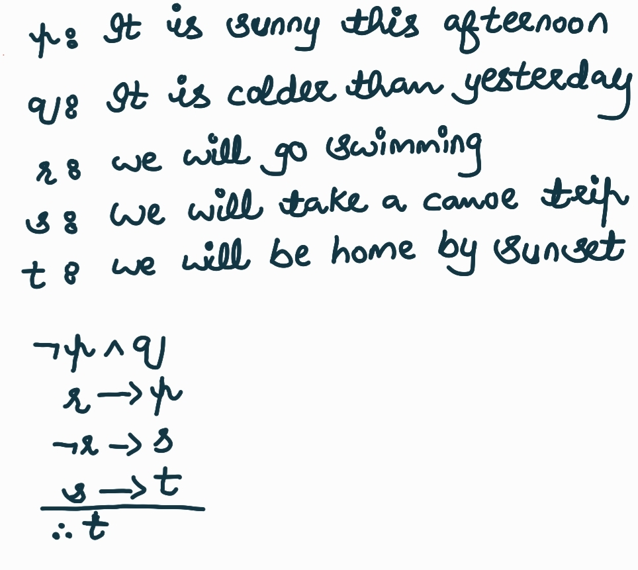
Lecture Outline
Inference Rules: Propositional and Building Arguments
Example 1:
Show that the premises “It is not sunny this afternoon and it is colder than yesterday,” “We will go swimming only if it is sunny,” “If we do not go swimming, then we will take a canoe trip,” and “If we take a canoe trip, then we will be home by sunset” lead to the conclusion “We will be home by sunset.”

Slide 58
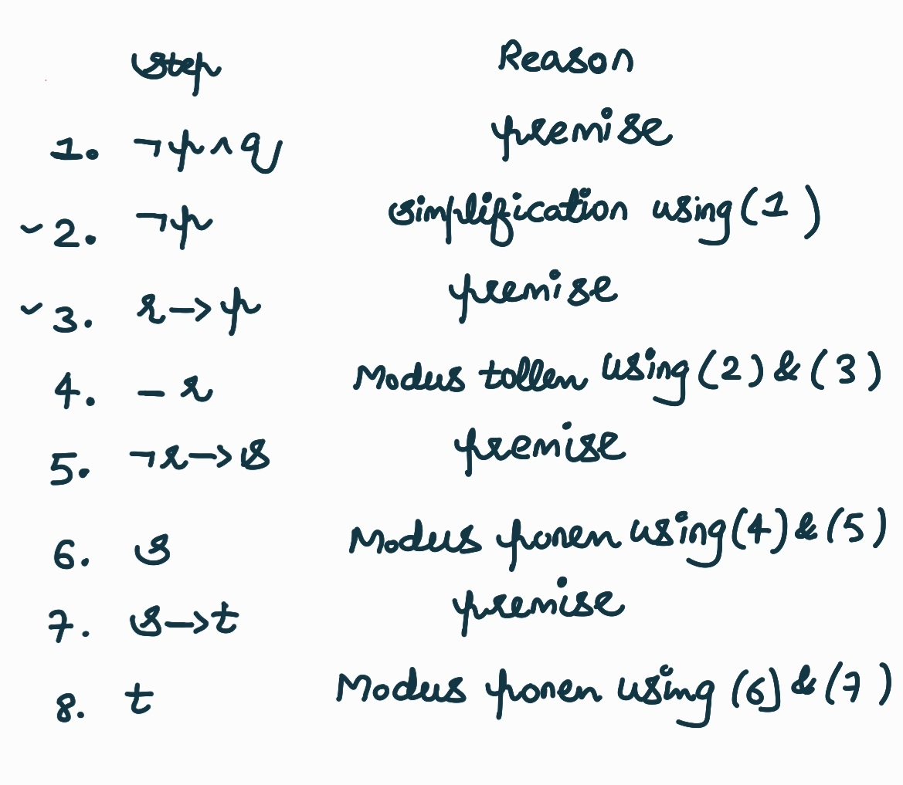
Lecture Outline
Inference Rules: Propositional and Building Arguments
Example 1:
Show that the premises “It is not sunny this afternoon and it is colder than yesterday,” “We will go swimming only if it is sunny,” “If we do not go swimming, then we will take a canoe trip,” and “If we take a canoe trip, then we will be home by sunset” lead to the conclusion “We will be home by sunset.”

Slide 59
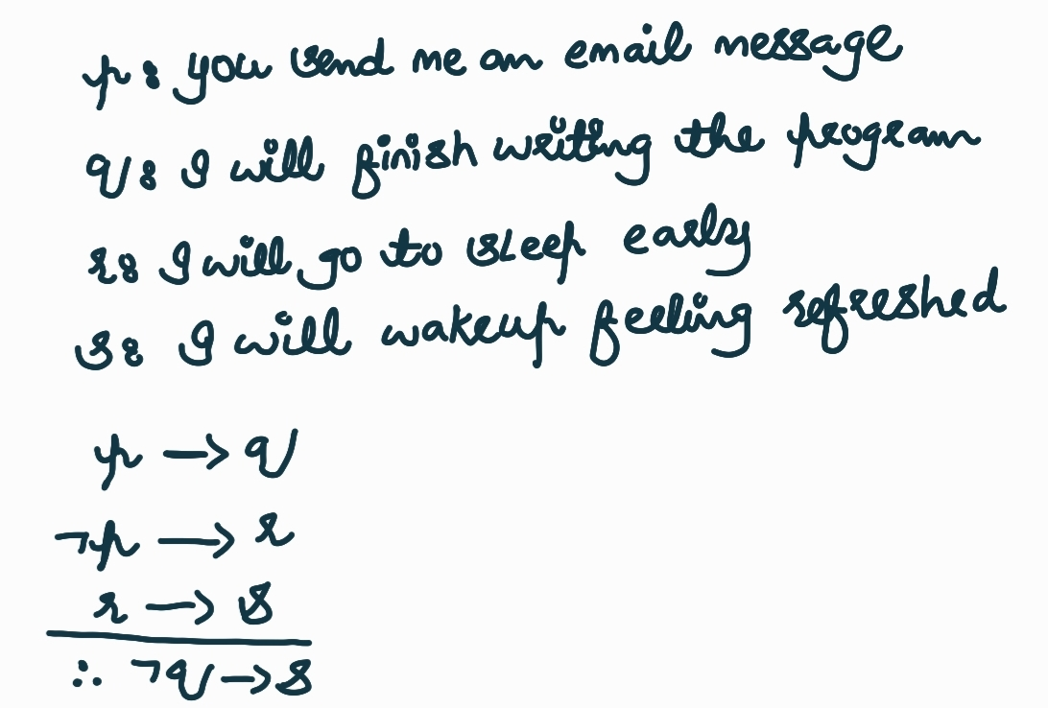
Lecture Outline
Inference Rules: Propositional and Building Arguments
Example 2:
Show that the premises “If you send me an e-mail message, then I will finish writing the program,” “If you do not send me an e-mail message, then I will go to sleep early,” and “If I go to sleep early, then I will wake up feeling refreshed” lead to the conclusion “If I do not finish writing the program, then I will wake up feeling refreshed.”

Slide 60
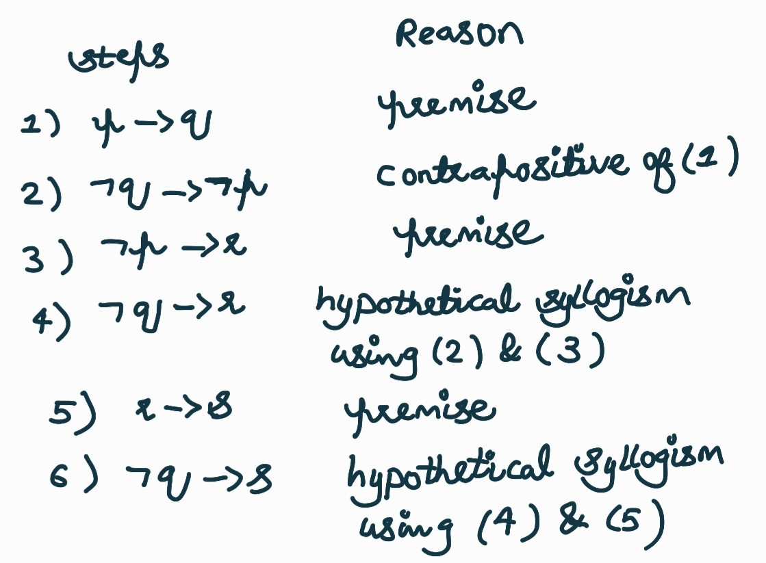
Lecture Outline
Inference Rules: Propositional and Building Arguments
Example 2:
Show that the premises “If you send me an e-mail message, then I will finish writing the program,” “If you do not send me an e-mail message, then I will go to sleep early,” and “If I go to sleep early, then I will wake up feeling refreshed” lead to the conclusion “If I do not finish writing the program, then I will wake up feeling refreshed.”

